Slide 1
Predicate Logic

Slide 2
What is a predicate?
Predicates are functions of zero or more variables that return Boolean values.
Predicate → T/F
Example: csg(C, S, G).
csg --> predicate name, C, S, and G are arguments.
It returns the value TRUE whenever the values of C, S, and G are such that student S got grade G in course C, and it returns FALSE otherwise

Slide 3
Predicates
(or functions returning True or False)
Functions which denote attributes of objects or relationships between individuals
Starting with a uppercase letter
Man(SOCRATES)
Friend(JOHN, JOE)
Sunny(THURDAY)

Slide 4
Why predicate - example?
A predicate is a generalization of a propositional variable
Consider three propositions:
r (“It is raining”),
u (“Joe takes his umbrella”)
w (“Joe gets wet”).
Suppose further that we have three hypotheses, or expressions that we assume are true:
r → u : If it rains, then Joe takes his umbrella
u → w : If Joe takes an umbrella, then he doesn’t get wet
r¯ → w : If it doesn’t rain, Joe doesn’t get wet

Slide 5
Suppose that what is true for Joe
is also true for Mary, and Sue, and Bill, and so on
Suppose that you have,
Mary takes her umbrella
Sue takes her umbrella
Bill takes his umbrella
. . . . . .
Instead of an infinite collection of propositions, define predicates with argument(s)

Slide 6
Logical Operations
Logical operators which computes truth values
∧ AND
∨ OR
¬ NOT
--> IMPLIES

Slide 7
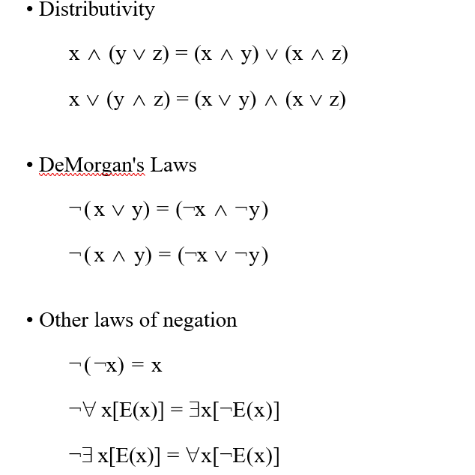
Logical Operations

Slide 8
Quantifiers
Logical operators which assert the scope of a predicate
∀ For All (universal quantifier)
∃ There Exists (existential quantifier

Slide 9
Literals
A term is an object, a variable, or a function
An atomic formula (atom) is a predicate with a proper number of arguments (terms)
literal is either an atom or the negation of an atom
No Quantifiers

Slide 10
Well-formed Formulas (wffs)
Defined recursively
Literals are wffs
wffs connected by ¬, ∧, ∨, and → are wffs
wffs surrounded by quantifiers are wffs

Slide 11
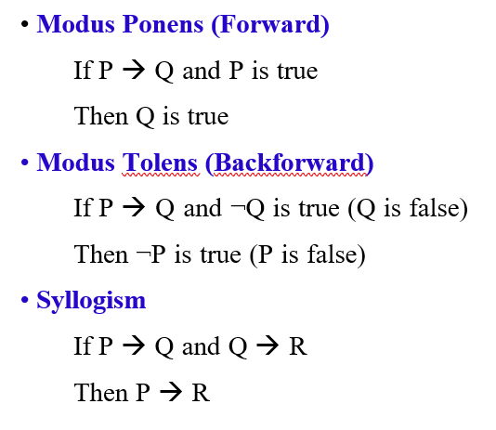
Laws of Inference

Slide 12
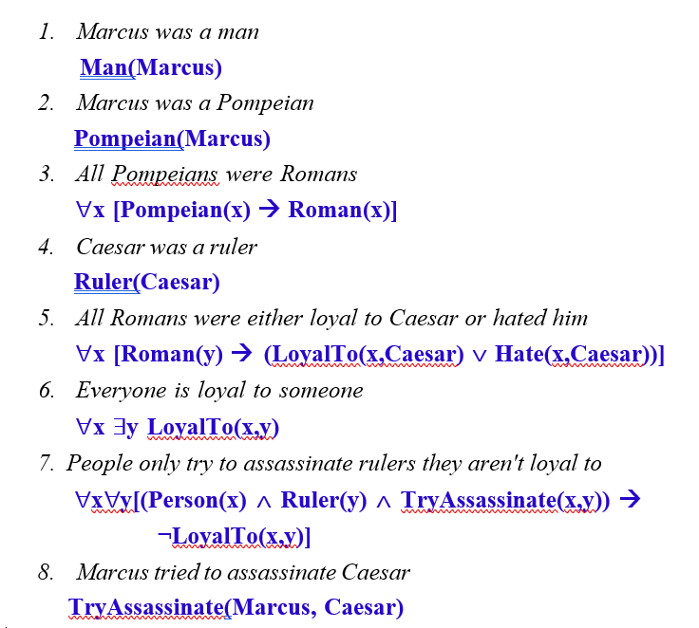

Natural Language Sentences to Predicate Logic

Slide 13
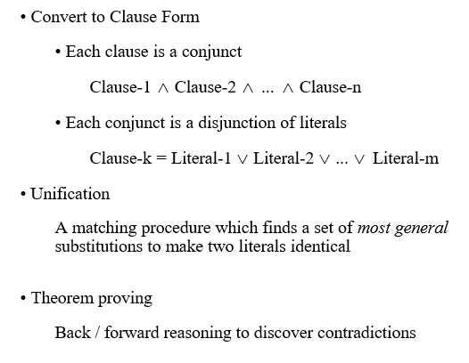
Resolution

Slide 14
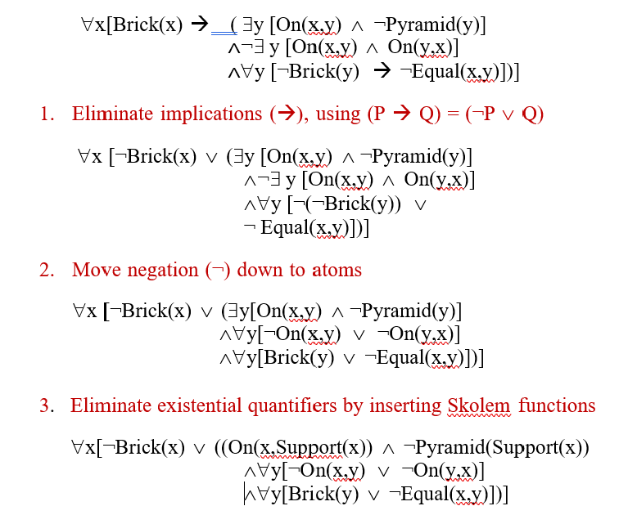
Conversion into clause form

Slide 15
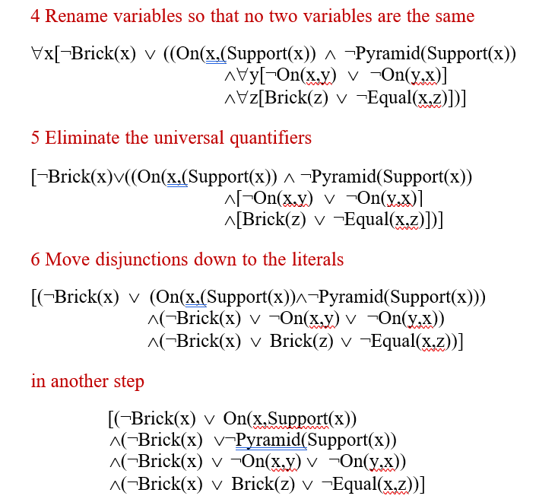

Slide 16
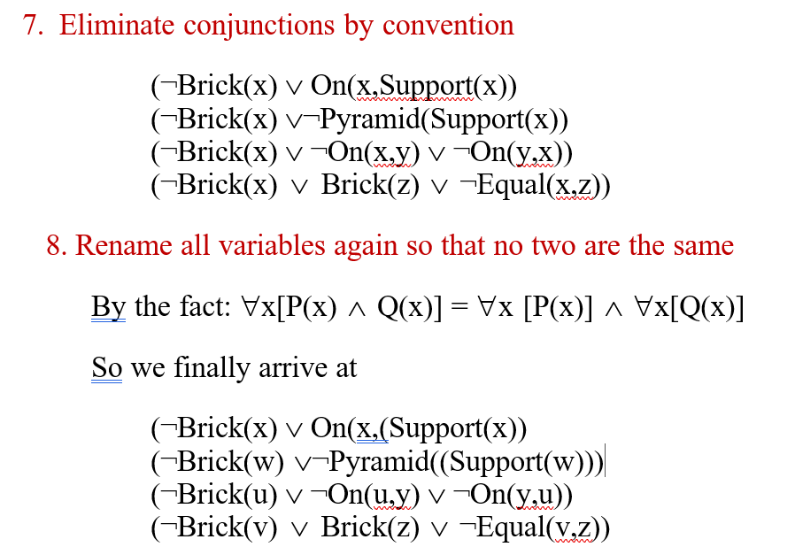

Slide 17
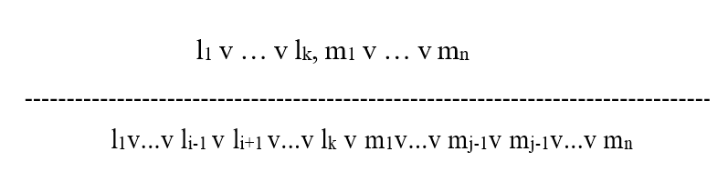
Resolution
Resolution has its roots in Mathematical Logic
Resolution Principle
l_{i} and m_{j} are complementary literals. Resolution takes two clauses and produces a new clause containing all the literals of the two original clauses except the two complementary literals

Slide 18
Unification
P (Marcus)
P (y) ==> {y → Marcus} (or Marcus/y)
P(x,x)
P(y,z) ==> {x → y, y → z}

Slide 19
Resolution Algorithm
Resolution works by using the principle of proof by contradiction.
To find the conclusion we should negate the conclusion.
Resolution rule is applied to the resulting clauses.
Each clause that contains complementary literals is resolved to produce a new clause, which can be added to the set of facts (if it is not already present).

Slide 20
Steps for Resolution
Convert the given statements in Predicate/Propositional Logic
Convert these statements into Conjunctive Normal Form
Negate the Conclusion (Proof by Contradiction)
Resolve using a Resolution Tree (Unification

Slide 21
Steps to Convert to CNF (Conjunctive Normal Form)
Every sentence in Propositional Logic is logically equivalent to a conjunction of disjunctions of literals.
A sentence expressed as a conjunction of disjunctions of literals is said to be in Conjunctive normal Form or CNF.
1. Eliminate implication ‘→’ a → b = ~a v b
~ (a ^ b) = ~ a v ~ b DeMorgan’s Law
~ (a v b) = ~ a ^ ~ b DeMorgan’s Law
~ (~a) = a

Slide 22
2. Eliminate Existential Quantifier ‘∃’
To eliminate an independent Existential Quantifier, replace the variable by a Skolem constant. This process is called as Skolemization.
Example: ∃y: President (y)
Here ‘y’ is an independent quantifier so we can replace ‘y’ by any name (say – George Bush).
So, ∃y: President (y) becomes President (George Bush).
To eliminate a dependent Existential Quantifier we replace its variable by Skolem Function that accepts the value of ‘x’ and returns the corresponding value of ‘y.’
Example: ∀x : ∃y : father_of (x, y)
Here ‘y’ is dependent on ‘x’, so we replace ‘y’ by S(x).
So, ∀x : ∃y : father_of (x, y) becomes ∀x : ∃y : father_of (x, S(x)).

Slide 23
3) Eliminate Universal Quantifier ‘∀’
To eliminate the Universal Quantifier, drop the prefix in PRENEX NORMAL FORM i.e. just drop ∀ and the sentence then becomes in PRENEX NORMAL FORM.
4) Eliminate AND ‘^’
a ^ b splits the entire clause into two separate clauses i.e. a and b
(a v b) ^ c splits the entire clause into two separate clauses a v b and c
(a ^ b) v c splits the clause into two clauses i.e. a v c and b v c

Slide 24
Ravi likes peanuts using resolution.
Ravi likes all kind of food.
Apples and chicken are food
Anything anyone eats and is not killed is food
Ajay eats peanuts and is still alive
Rita eats everything that Ajay eats

Slide 25
Solution:
Step 1: Converting the given statements into Predicate/Propositional Logic
∀x : food(x) → likes (Ravi, x)
food (Apple) ^ food (chicken)
∀a : ∀b: eats (a, b) ^ killed (a) → food (b)
eats (Ajay, Peanuts) ^ alive (Ajay)
∀c : eats (Ajay, c) → eats (Rita, c)
∀d : alive(d) → ~killed (d)
∀e: ~killed(e) → alive(e)
Conclusion: likes (Ravi, Peanuts)
Ravi likes all kind of food.
Apples and chicken are food
Anything anyone eats and is not killed is food
Ajay eats peanuts and is still alive
Rita eats everything that Ajay eats

Slide 26
Step 2: Convert into CNF
~food(x) v likes (Ravi, x)
Food (apple)
Food (chicken)
~ eats (a, b) v killed (a) v food (b)
Eats (Ajay, Peanuts)
Alive (Ajay)
~eats (Ajay, c) V eats (Rita, c)
~alive (d) v ~ killed (d)
Killed (e) v alive (e)
Conclusion: likes (Ravi, Peanuts)
Step 3: Negate the conclusion
~ likes (Ravi, Peanuts)

Slide 27
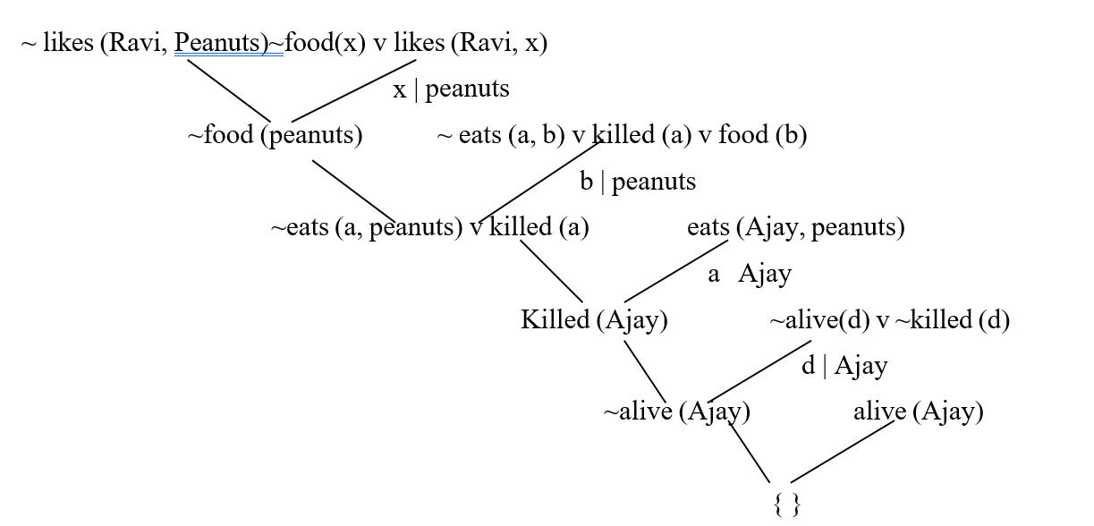

Slide 28
Example
Whoever can read is literate
Dolphins are not literate
Some Dolphins are intelligent
PROVE
Some who are intelligent cannot read

Slide 29
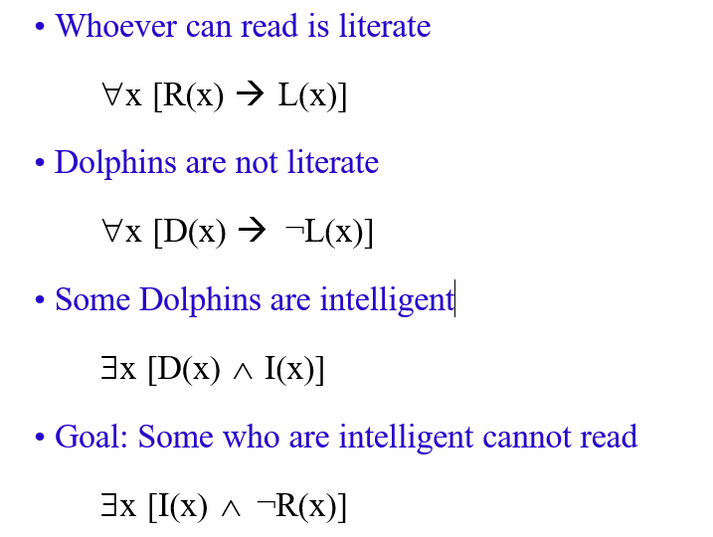
Translate into predicate logic

Slide 30
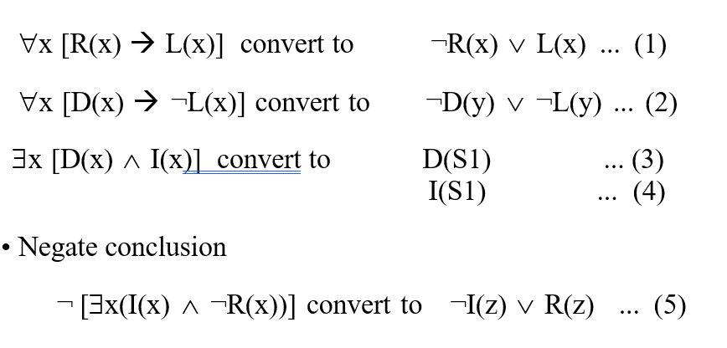
Convert it into Clause form

Slide 31
